Slide 1
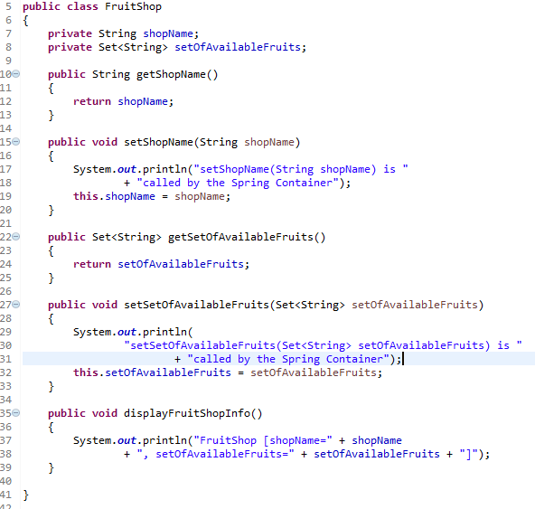
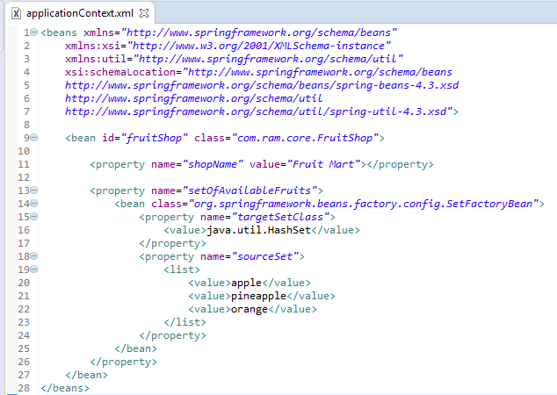
SerFactoryBean to create a concrete Set Collection class (HashSet and TreeSet)
The ‘SetFactoryBean‘ class provides a way to create a concrete Set Collection (HashSet and TreeSet) in Spring’s bean configuration file.
SetFactoryBean will instantiate an HashSet at runtime, and inject it into a bean property.

Slide 2
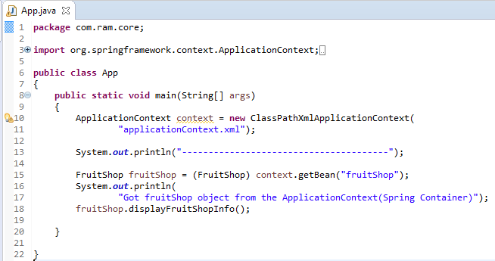
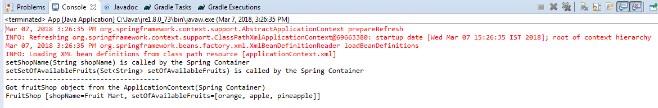
SerFactoryBean to create a concrete Set Collection class (HashSet and TreeSet)

